Slide 1
PS, Sabiny, Venkat, Gana
AI Project-Computer Vision
To detect PPE safety violation by construction workers using IBM Watson Studio Visual Recognition Tool
http://www.free-powerpoint-templates-design.com

Slide 2
PPE Safety Detection
Using Computer Vision
IBM SGUNITED IMVAI-0402 TEAM 2 AI PROJECT April.’21

Slide 3
Agenda
1. Introduction - Project Intent
2. Problem Statement
3. Proposed Solution - Data
4. Data to support the solution
5. Flow of Solution - Understanding
6. Expected Output - Reasoning
7. Future Improvements - Knowledge
Lee, Sabiny, Venkat, Gana

Slide 4
Agenda
1. Introduction - Project Intent
2. Problem Statement
3. Proposed Solution - Data
4. Data to support the solution
5. Flow of Solution - Understanding
6. Expected Output - Reasoning
7. Future Improvements - Knowledge
Lee, Sabiny, Venkat, Gana

Slide 5
INTRODUCTION

Slide 6
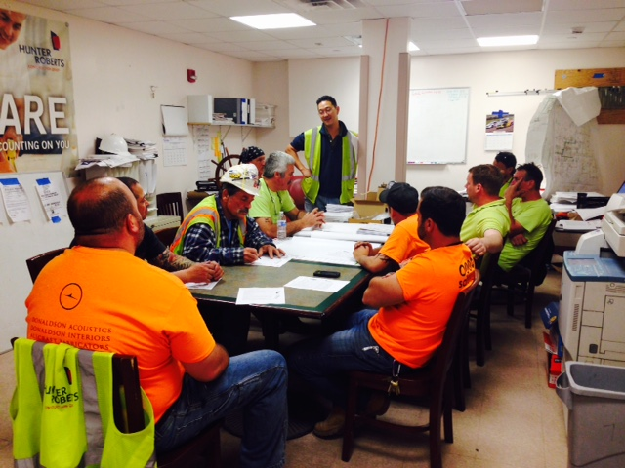
Problem Statement
We’re contacted by the IT-Safety Team of ABC Chemical Co. to help them to improve their safety record by tracking & enforcing PPE compliance by on-site construction workers.
There are few full time Safety Officers while the number of worksites and workers are numerous and physical walkabouts by the S.O. are insufficient to detect all violations and take prompt remedial measures.
Lee, Sabiny, Venkat, Gana

Slide 7
Problem Statement
We’re contacted by the IT-Safety Team of ABC Chemical Co. to help them to improve their safety record by tracking & enforcing PPE compliance by on-site construction workers.
There are few full time Safety Officers while the number of worksites and workers are numerous and physical walkabouts by the S.O. are insufficient to detect all violations and take prompt remedial measures.
Lee, Sabiny, Venkat, Gana

Slide 8
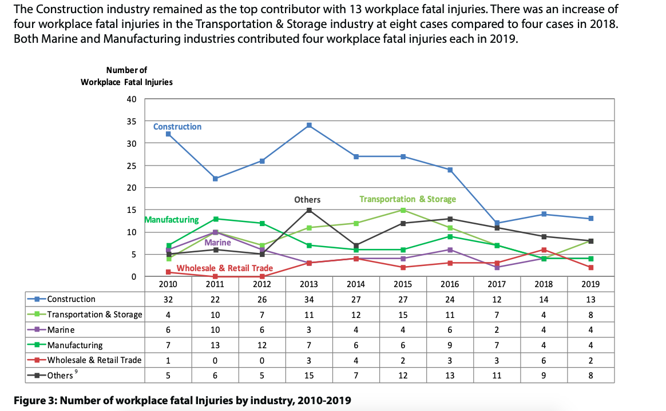
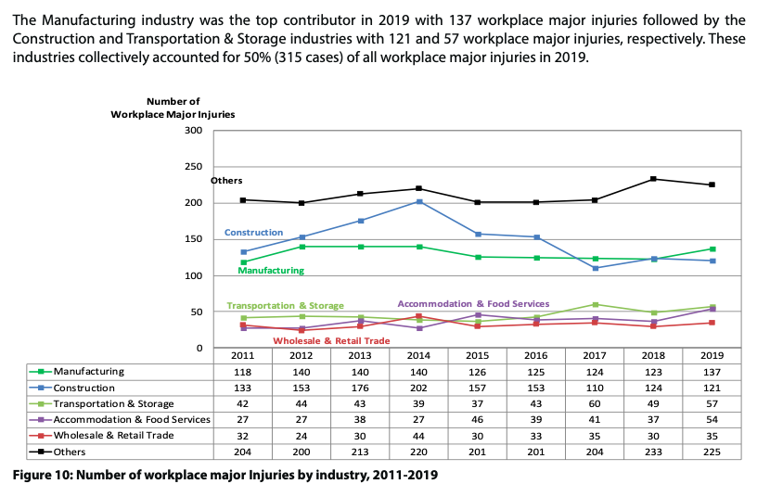
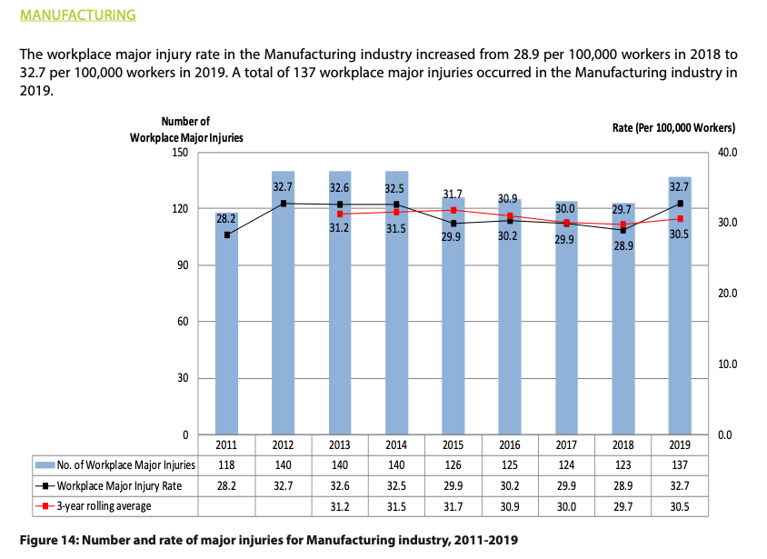
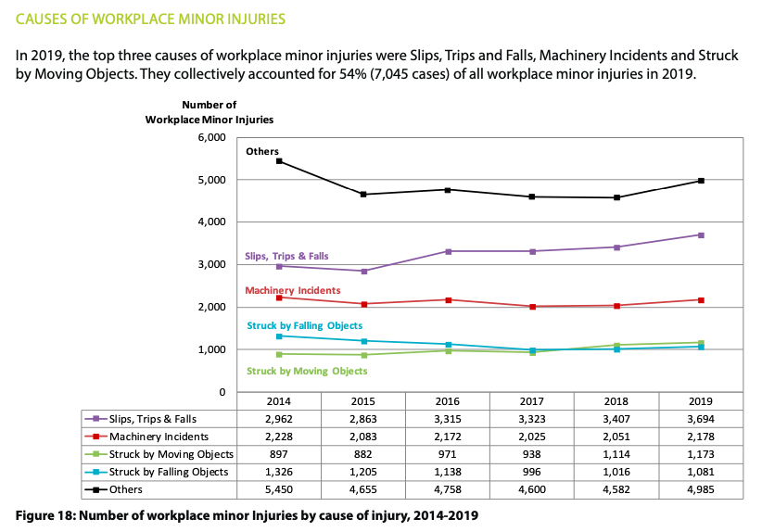
Workplace Safety in Singapore - Some statistics
Source: Workplace Safety & Health Report, 2019 - MOM

Slide 9
Workplace Safety in Singapore- Some statistics
Lee, Sabiny, Venkat, Gana

Slide 10
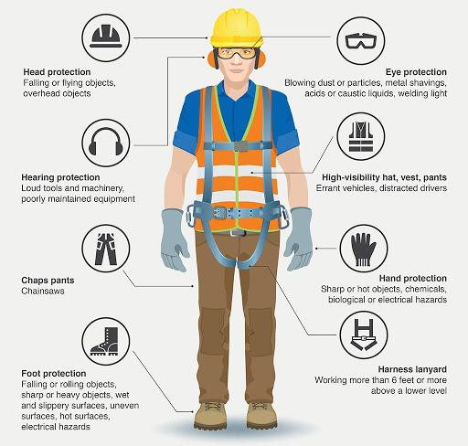
PPE Safety Requirements for on-site workers
Business Challenges
Safety has always been a No.1 concern on construction or maintenance site in industry.
On site construction and/or maintenance workers are required by Law to wear basic Personal Protective Equipment (PPE) besides undergoing structured safety oriented trainings.
On site Safety Officer(s) check for safety breaches by conducting walkabout and has the power to stop work if he so deemed the breaches put any worker in unhealthy and/or unsafe environment.
Basic PPE for each worker are: Safety helmet, eye safety glasses, hand gloves, hard toe protected boots, coveralls and ear pieces where the noise level could pose risk to long term hearing.
However, it’s still not uncommon that, due either to convenience or comfort, that one or more workers remove one or more of the basic PPE during works.
Due to numerous worksites and workers to be supervised, the few Safety Officers find it very challenging to detect visually any such breaches.
Personal Protective Equipment
PS, Sabiny, Venkat, Gana

Slide 11
Business Challenges
Safety has always been a No.1 concern on construction
or maintenance site in industry.
On site construction and/or maintenance workers are required by Law to wear basic Personal Protective Equipment (PPE) besides undergoing structured safety oriented trainings.
On site Safety Officer(s) check for safety breaches by conducting walkabout and has the power to stop work if he so deemed the breaches put any worker in unhealthy and/or unsafe environment.
Basic PPE for each worker are: Safety helmet, eye safety glasses, hand gloves, hard toe protected boots, coveralls and ear pieces where the noise level could pose risk to long term hearing.
However, it’s still not uncommon that, due either to convenience or comfort, that one or more workers remove one or more of the basic PPE during works.
Due to numerous worksites and workers to be supervised, the few Safety Officers find it very challenging to detect visually any such breaches.
Personal Protective Equipment(PPE)
Lee, Sabiny, Venkat, Gana

Slide 12
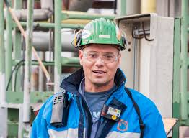
Says
Due to the weather, workers tend to remove helmet and /or Goggles which are the most common violations.
Thinks
Need to find a less stressful job
Better way to detect and manage safety violations
Near impossible to recruit additional staff due to Budget constraint.
How do i make sure we have 100% safely record for the year.
Safety is major concern for management.
MOM regulation very strict.
Too many sites & workers to oversee.
Shortage of staff to manage the safety issue.
Safety lapses have severe consequences, including fatality, and financial impact.
I got a meeting , will the worker on site wearing proper PPE or should i send other safety officer to check
Find the solution to reduce the percentage of accidents in the site
I am overwhelmed at site with so many workers that it’s difficult to detect safety violation and can use some help
Safety is a huge problem for construction
I think there must be a technological solutions to help me with so many IOT products around!
Alex Tan, Safety Officer,
ABC Chemical Pte Ltd
Does
Check each area of sites individually and make sure that they are properly wearing their safety equipments.
Stressed , Tired , Mental / Physical Fatigue.
Unable to supervise all sites feels down on the job
Feels
Ensures & checks all the workers were proper PPE( Personal protective Equipments). Like Hard hat , Safety boots , Gloves , Goggles , Coverall , earbuds
I have to be constantly walking about to visit all the job sites to ensure everyone is following safety rules to preempt accidents and injury.
I feel that there are just too many workers to effectively supervise.
The Safety officer brief in the toolbox meeting everyday on the safety hazard
If someone gets hurt , there’ll be tons of investigations & reports to MOM & management!
I feel exhausted walking most of the times and visually try to catch safety violation
Move from site to site to supervise safety compliance..
Ensure that safety regulation is understood by all officers
Attend to issues that are highlighted by officers
Manage lapses and attend to Management Query on lapses
Feels awful when seeing accidents on the site.
Lee, Sabiny, Venkat, Gana

Slide 13
Empathy Map
SAYS
THINKS
Safety is major concern for management. MOM regulation very strict.
Too many sites & workers to oversee. Shortage of staff to manage the safety issue. Safety lapses have severe consequences, including fatality, and financial impact.
Need to find a less stressful job Better way to detect and manage safety violations. Near impossible to recruit additional staff due to Budget constraint. How do i make sure we have 100% safely record for the year.
Due to the weather, workers tend to remove helmet and /or Goggles which are the most common violations.
I got a meeting , will the worker on site wearing proper PPE or should i send other safety officer to check
Find the solution to reduce the percentage of accidents in the site
I am overwhelmed at site with so many workers that it’s difficult to detect safety violation and can use some help
I think there must be a technological solutions to help me with so many IOT products around!
Safety is a huge problem for construction
Alex Tan, Safety Officer,
ABC Chemical Pte Ltd
DOES
FEELS
Ensures & checks all the workers were proper PPE( Personal protective Equipments). Like Hard hat , Safety boots , Gloves , Goggles , Coverall , earbuds
I feel that there are just too many workers to effectively supervise.
I feel exhausted walking most of the times and visually try to catch safety violation
Move from site to site to supervise safety compliance. Ensure that safety regulation is understood by all officers. Attend to issues that are highlighted by officers Manage lapses and attend to Management Query on lapses
Feels awful when seeing accidents on the site.
I have to be constantly walking about to visit all the job sites to ensure everyone is following safety rules to preempt accidents and injury.
Stressed , Tired , Mental / Physical Fatigue. Unable to supervise all sites feels down on the job
If someone gets hurt , there’ll be tons of investigations & reports to MOM & management!
Check each area of sites individually and make sure that they are properly wearing their safety equipments.
The Safety officer brief in the toolbox meeting everyday on the safety hazard
Lee, Sabiny, Venkat, Gana

Slide 14

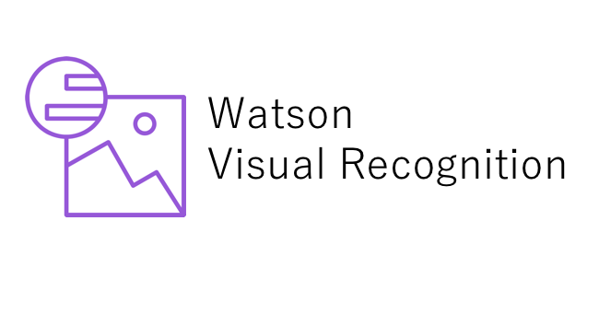
As-is pain points
Due to the hot & humid conditions at typical jobsite, workers tend to become lax over the course of the day and often remove either safety goggle or helmet while working. These are dangerous violations as they are then without the minimum protection against the work environment.
Physically not possible to monitor staff at all times over many sites.
Safety staff stress is very high due to constant verbal interactions with project staff.
Increased project locations to monitor with same number of staff and staff rotation in 18 hour shifts
Workers ignoring their rules and regulations
Safety violations are costly in terms of potential injury & even death when accidents happened. This is on top of penalty that can be imposed by MOM and insurance premium and stop works loss to the various stakeholders.
It’s very difficult for a person to visually detect all safety violation due to the number of workers working at different areas over many hours in a day.
Concerned with operation and management cost
Some Worker working over time tend to be tired wearing helmet & goggles ,so removes for a while & forget to put back .
Human errors are one of the major underlying causes of industrial accidents with dire consequences for both individual, family and businesses.
Lee, Sabiny, Venkat, Gana

Slide 15
As-is pain points
Physically not possible to monitor staff at all times over many sites.
Safety staff stress is very high due to constant verbal interactions with project staff.
Increased project locations to monitor with same number of staff and staff rotation in 18 hour shifts
It’s very difficult for a person to visually detect all safety violation due to the number of workers working at different areas over many hours in a day.
Some Worker working over time tend to be tired wearing helmet & goggles ,so removes for a while & forget to put back .
Due to the hot & humid conditions at typical jobsite, workers tend to become lax over the course of the day and often remove either safety goggle or helmet while working. These are dangerous violations as they are then without the minimum protection against the work environment.
Workers ignoring their rules and regulations
Safety violations are costly in terms of potential injury & even death when accidents happened. This is on top of penalty that can be imposed by MOM and insurance premium and stop works loss to the various stakeholders.
Human errors are one of the major underlying causes of industrial accidents with dire consequences for both individual, family and businesses.
Concerned with operation and management cost
Lee, Sabiny, Venkat, Gana

Slide 16
PROBLEM STATEMENT

Slide 17
Intent
How we plan to solve the problems using AI
6 Cores of Intents
Accelerate research and discovery
Easily process millions of data points to focus on the work that matters most.
Enrich your interactions
Train your AI on common requests to reduce response times, increase the number of transactions, and make interactions more productive
Anticipate and preempt disruption
Continuously monitor the condition of your systems to mitigate problems before they disrupt your work. Use AI to catch potential issues in the systems and processes that are essential to our business.
Recommend with confidence
Teach systems the nuances of your business to ensure every factor is considered so that you can make better-informed decisions, give tailored advice, and deepen customer relationships..
Scale expertise and learning
Evangelize the concept of AI By combining employee expertise with your industry’s latest learning. Make deep instructional knowledge available to everyone in your organization
Detect liabilities and mitigate risk
Train systems to understand and keep up with constantly changing regulations and privacy obligations. Identify compliance issues quickly and easily to protect your business and your people.
Benefits
Safety officer will be alerted to real time violation & can take action to enforce PPE compliance
Business & individual will benefit from uninterrupted safe workplace
Machine Vision system will be able to detect any worker removing or not wearing safety helmet during work with high degree of confidence and alert the S.O. to take action to enforce compliance
AI powered detection & alert system learns thru’ continuous real time on-site data to improve safety, mitigate physical risks, reduce insurance & legal liabilities while complying with MOM regulations.
Anticipate potential safety breaches through constant monitoring of work sites by implementing AI powered monitoring systems to detect PPE compliance by workers.
Lee, Sabiny, Venkat, Gana

Slide 18
Alignment of Intents
Anticipate and preempt disruption
Anticipate potential safety breaches through constant monitoring of work sites by implementing AI powered monitoring systems to detect PPE compliance by workers.
Recommend with confidence
The Safety officer will be prompted to take immediate action to enforce PPE standards, with high confidence in the detection of monitoring system which is much faster, almost real time, & automated.
Detect liabilities and mitigate risk
The ultimate goal for this Project is to aim for zero injury by way of PPE compliance.
Lee, Sabiny, Venkat, Gana

Slide 19
Alignment of Intents
Anticipate & Preempt disruptions
Anticipate potential safety breaches through constant monitoring of work sites by implementing AI powered monitoring systems to detect PPE compliance by workers.
Recommend with confidence
The Safety officer will be prompted to take immediate action to enforce PPE standards, with high confidence in the detection of monitoring system which is much faster, almost real time, & automated.
Detect liabilities and mitigate risk
The ultimate goal for this Project is to aim for zero injury by way of PPE compliance.
PS, Sabiny, Venkat, Gana

Slide 20
Problem Statement
How might we better support the Safety Officer in his supervision job to detect PPE safety breaches by on site workers so that he could take prompt preemptive measures to enforce compliance on the part of workers in order to achieve zero loss time injury (LTI).
Lee, Sabiny, Venkat, Gana

Slide 21
PROPOSED
SOLUTION

Slide 22
Big idea & Proposed Solution
Big Idea
Based on the team discussion the initial solution should address Safety Helmet compliance as this is arguably important and most common violation of the PPE.
Proposed Solution
Using AI technology, the PPE violation of safety helmet can be detected from camera feed and an automated alert mechanism can be established. We can improve the model to address the other Safety violations in future through iterative improvement.

Slide 23

Proposed Solution
AI-assisted PPE detection system can offer:
Using AI object detection model can monitor designated areas, identify PPEs safety violation & Alert the person/Worker & the Safety officer.
It can automatically notify the site safety officer if a PPE compliance breach was detected.
The video footage can be used for Further analysis.
AI system helps to ensure safety of the site workers & to achieve towards ultimate objective of zero Lost time Injury (LTI)
PS, Sabiny, Venkat, Gana

Slide 24
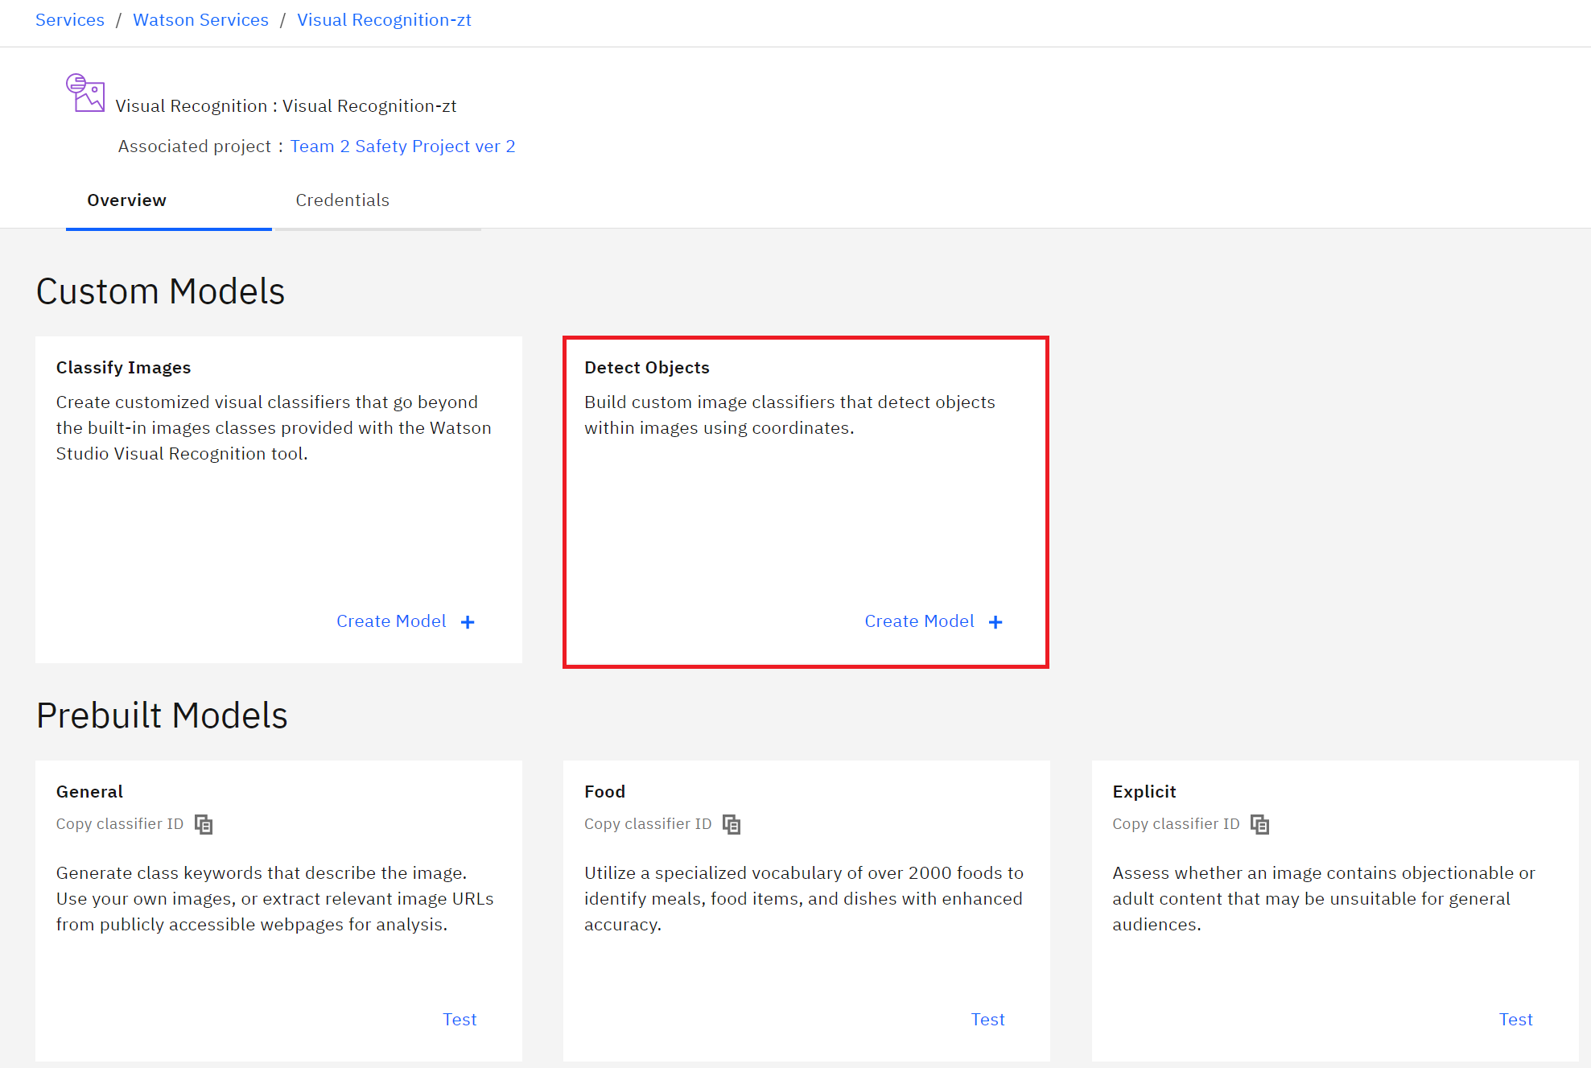
Visual Recognition Models
General model - Default classification from thousands of classes
Explicit model - Whether an image is inappropriate for general use
Food model - Specifically for images of food items
Pre-built Models
Custom Classification Model
Classify images according to your specific needs
Train a model to detect objects within images.
Object Detection Model
PS, Sabiny, Venkat, Gana

Slide 25
Object Detection Model
Pre-built Models
Object detection is similar to tagging, but need to create the bounding box coordinates for each object.
There are multiple objects of the same or different tags in an image
PS, Sabiny, Venkat, Gana

Slide 26
DATA TO SUPPORT
THE SOLUTION

Slide 27
Identify Data
Private Data
This type of data is owned by business entities and holds some competitive advantage in the market. For example, employee details, vendor details, units sold etc.
Live video streaming of workers entering the job site.
Public Data
As the name suggests, this data can be found on the internet for free. For example, census data, SEC filing reports, etc.
Publicly available bunch of pictures with people wearing Safety Helmets and people not wearing Safety Helmets.
User Data
This type of data is very much related to end-users. For example, medical records, Credit Card bills, address, etc.
PS, Sabiny, Venkat, Gana

Slide 28
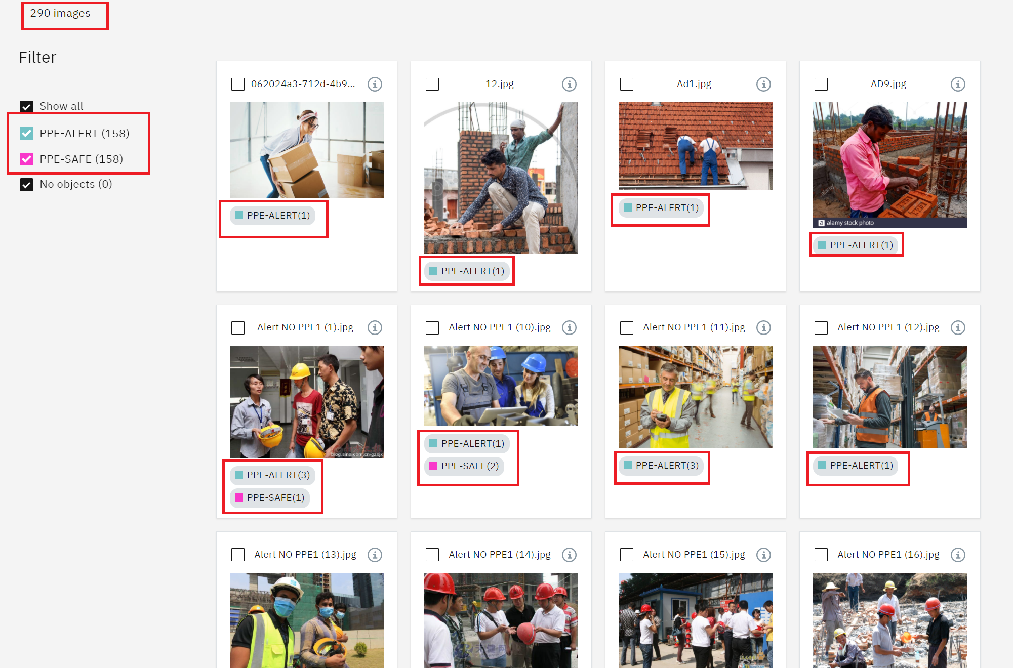
Data Collection
Our training data was 290 images.
Individual objects, objects in different distances conditions and different positioned objects were considered in our experiments to validate the robustness of our proposed approach.
Supported image file formats: JPEG (.jpg) with an average size of
2 classes of images: PPE-SAFE(wearing safety helmet)
PPE-ALERT(not wearing safety helmet)
PS, Sabiny, Venkat, Gana

Slide 29
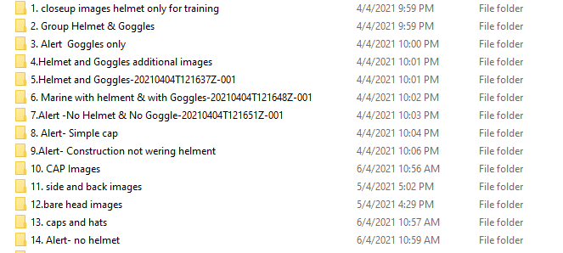

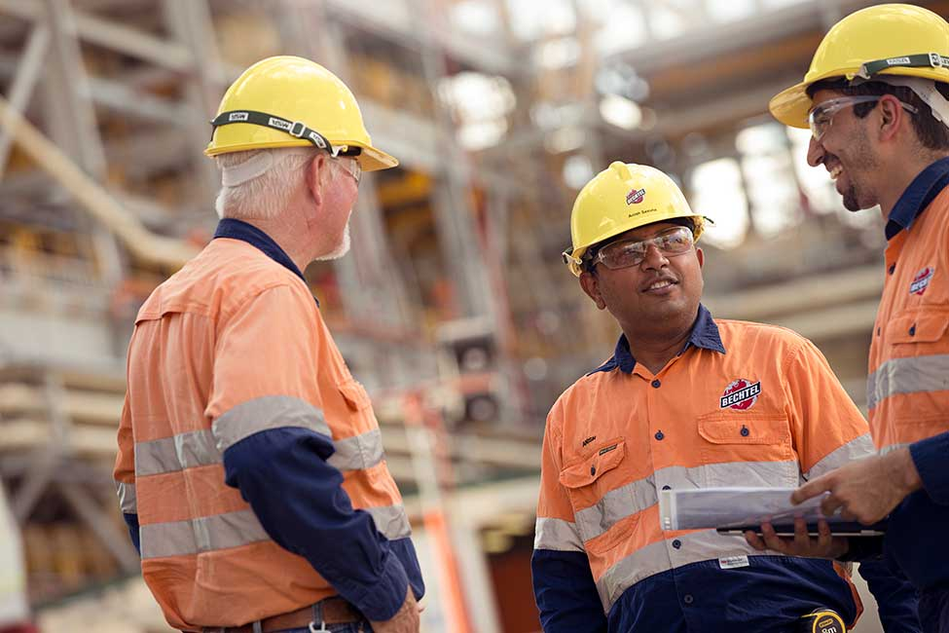
About Data
Types of images we collected:
Wearing safety helmet
Wearing normal hat or cap or cloth hat
Bare head images
Side and back view images
PS, Sabiny, Venkat, Gana

Slide 30
FLOW OF
SOLUTION

Slide 31
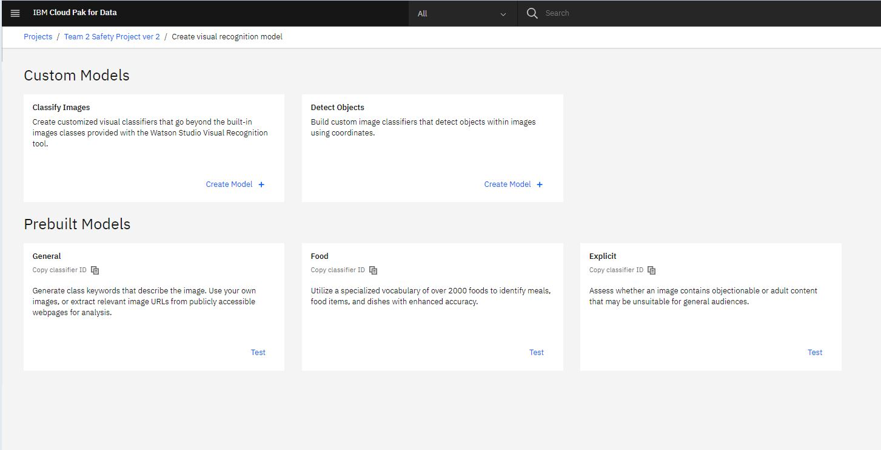
Visual Recognition Model Object Detection
PS, Sabiny, Venkat, Gana

Slide 32
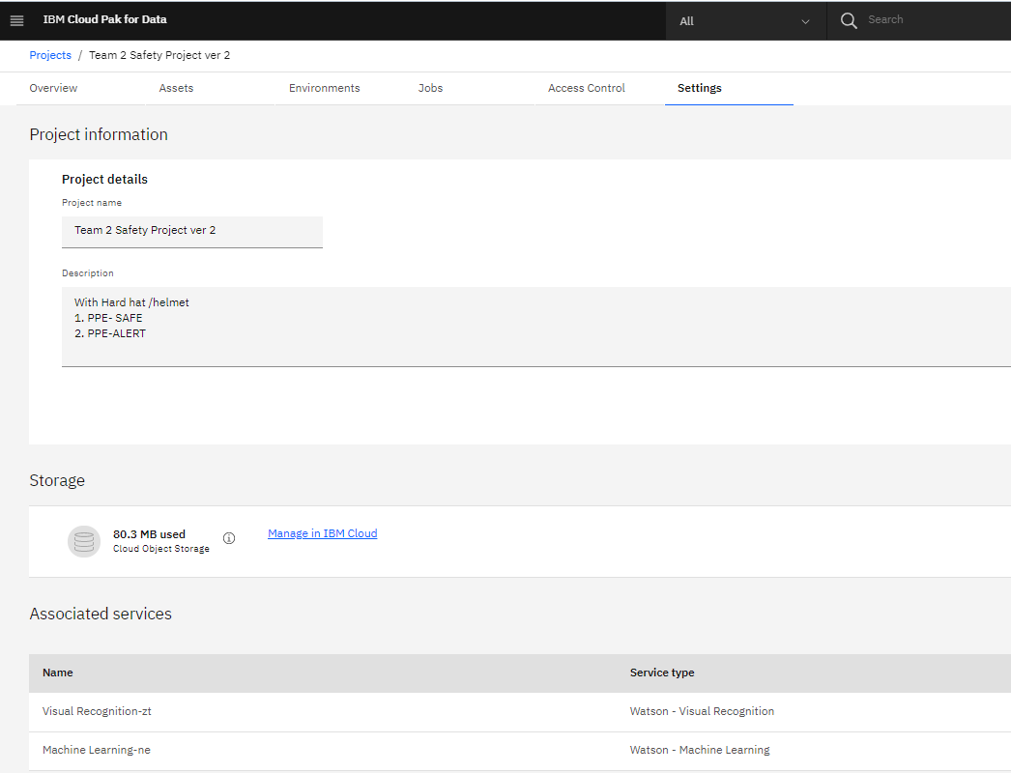
Project Information
PS, Sabiny, Venkat, Gana

Slide 33
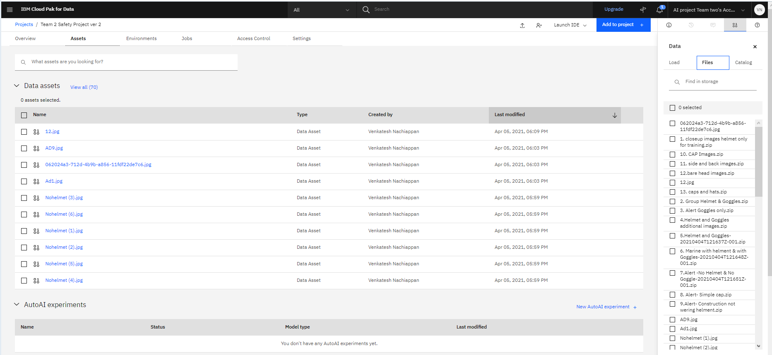
Assets - Data (Images)
PS, Sabiny, Venkat, Gana

Slide 34
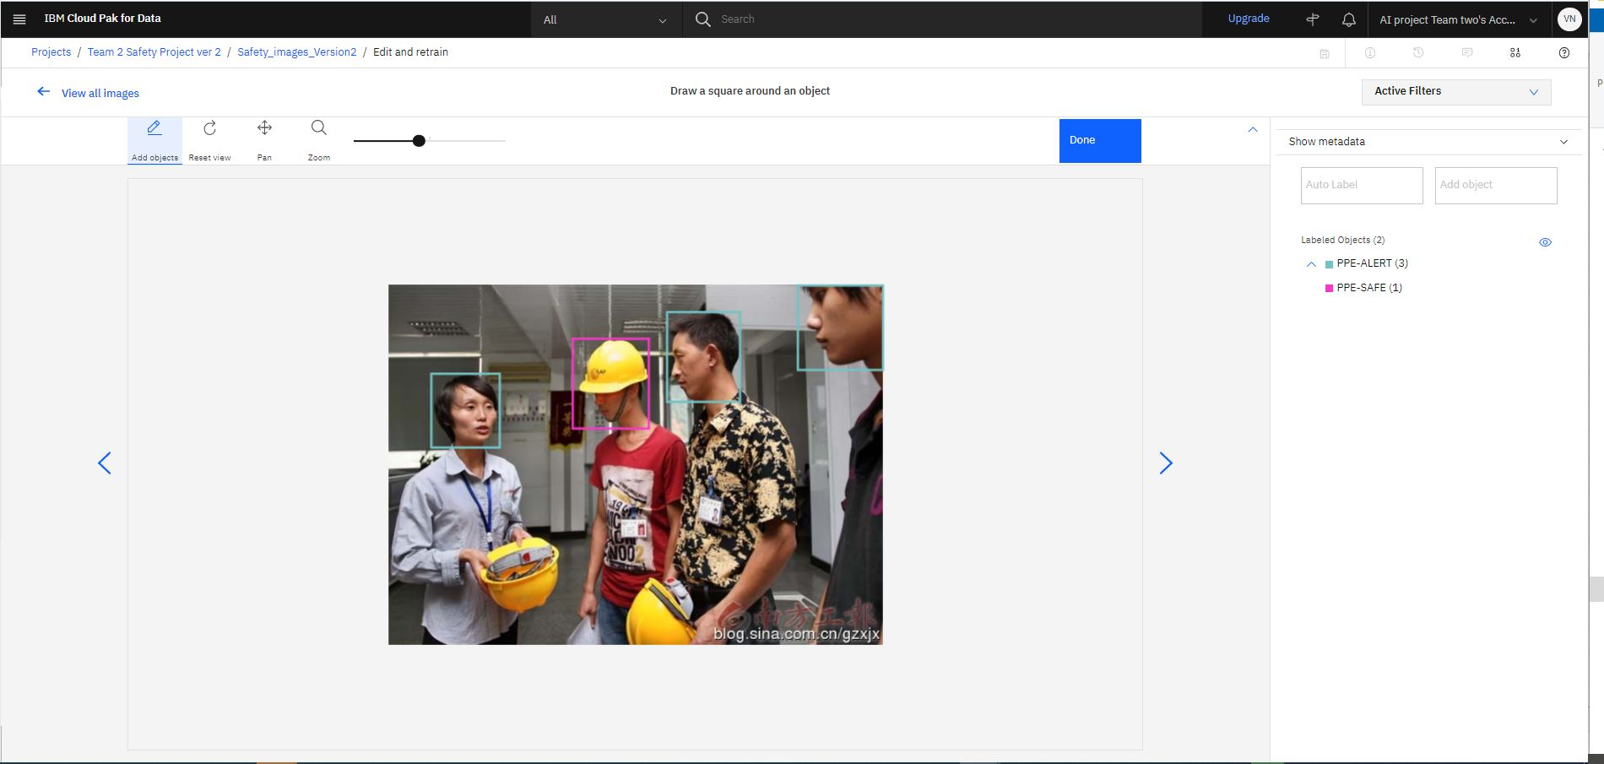
Labeling...
PS, Sabiny, Venkat, Gana

Slide 35
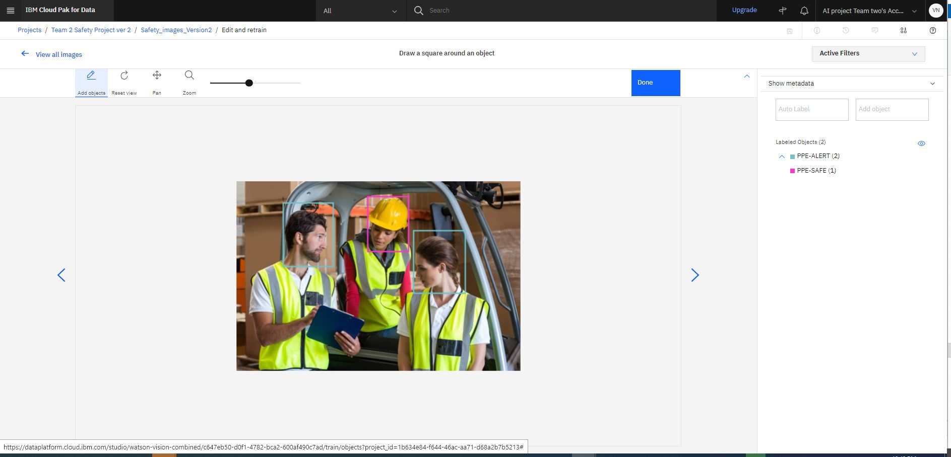
Labeling...
PS, Sabiny, Venkat, Gana

Slide 36
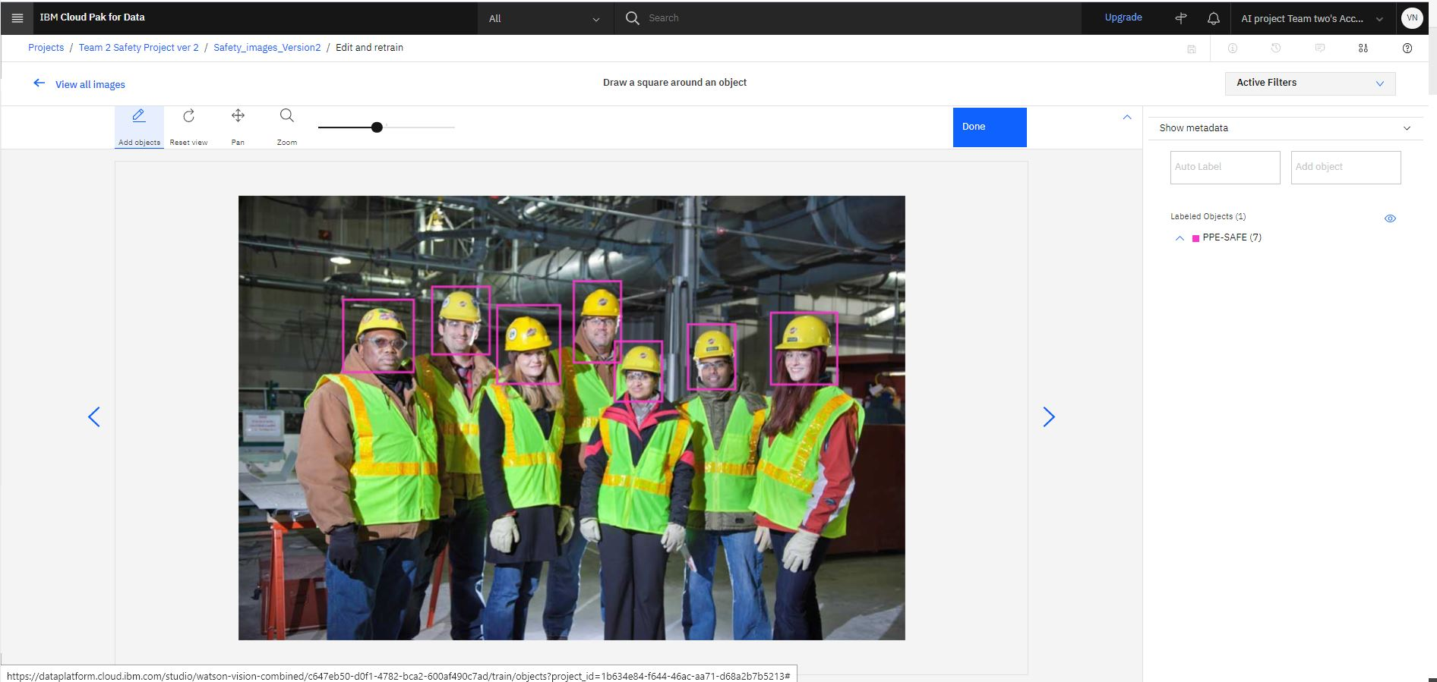
Labeling...
PS, Sabiny, Venkat, Gana

Slide 37
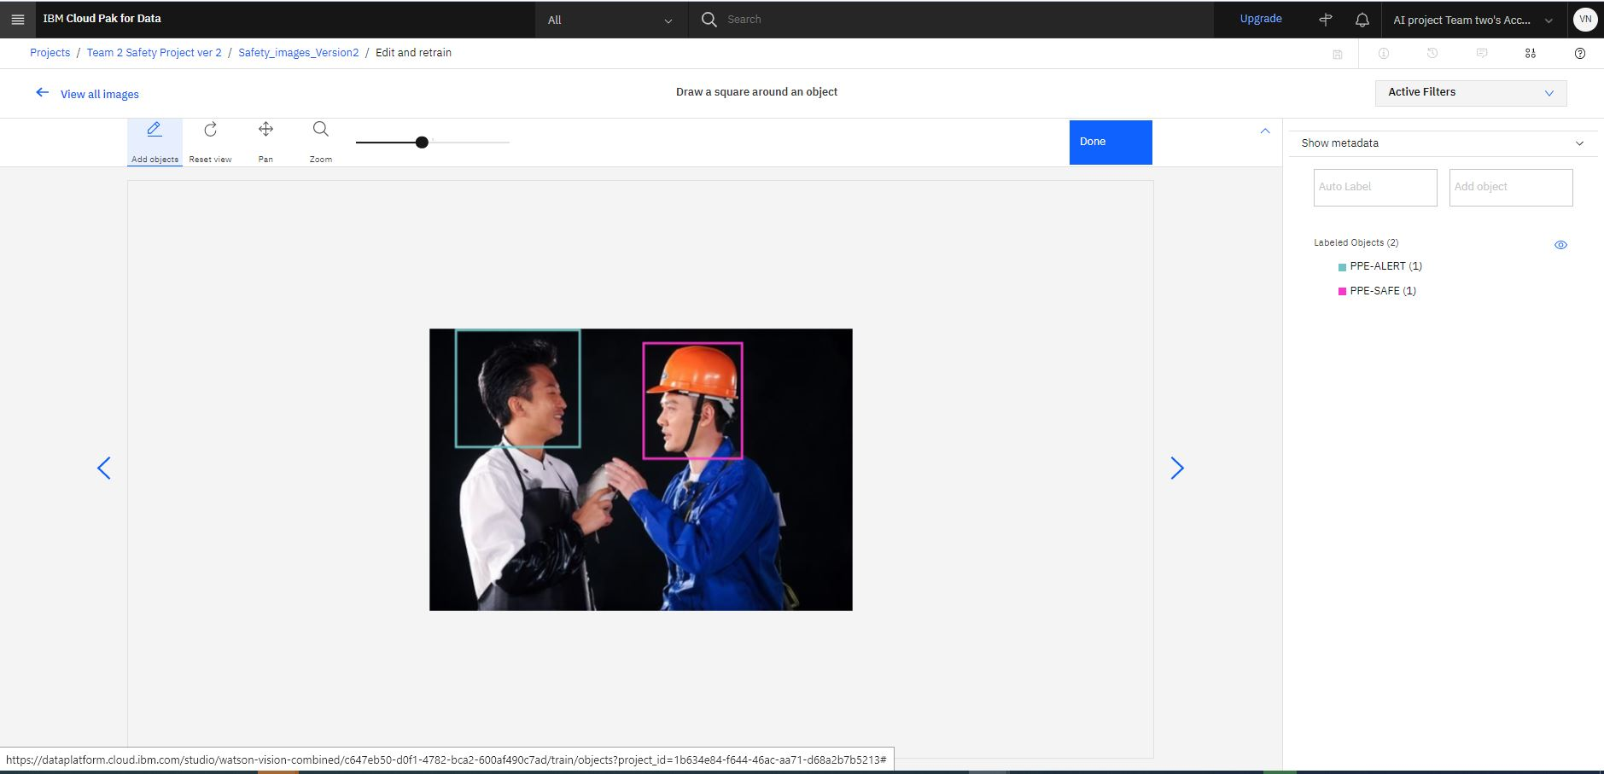
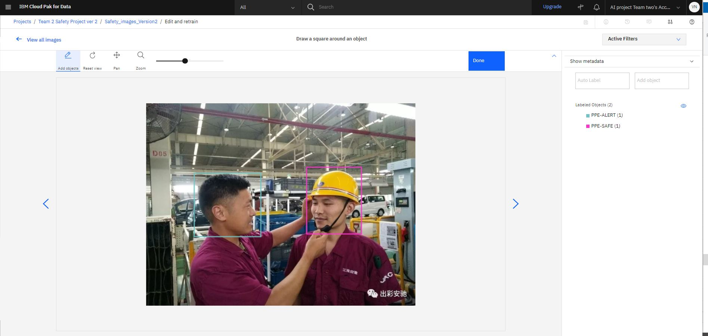
Labeling...
PS, Sabiny, Venkat, Gana

Slide 38
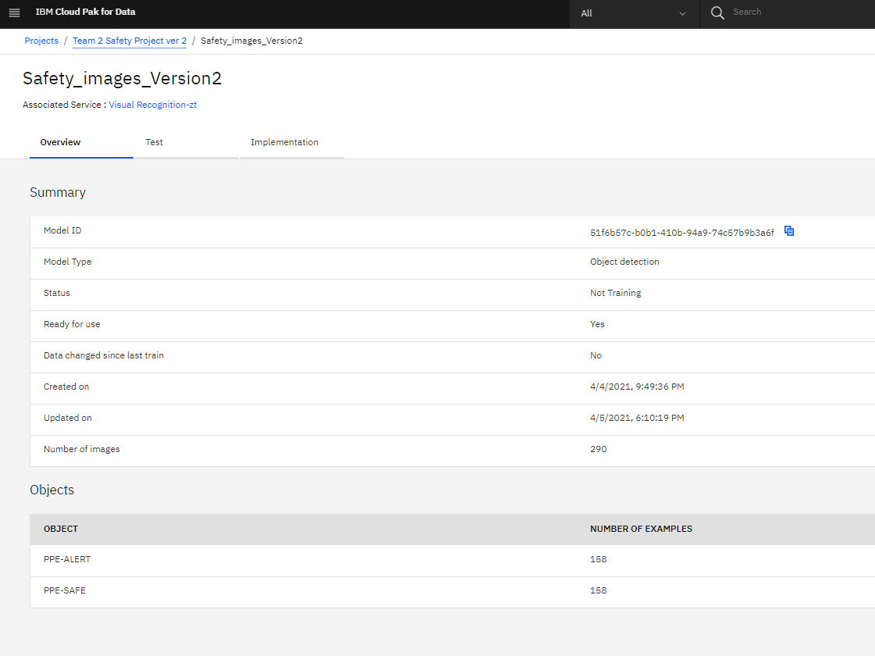
Overview
PS, Sabiny, Venkat, Gana

Slide 39
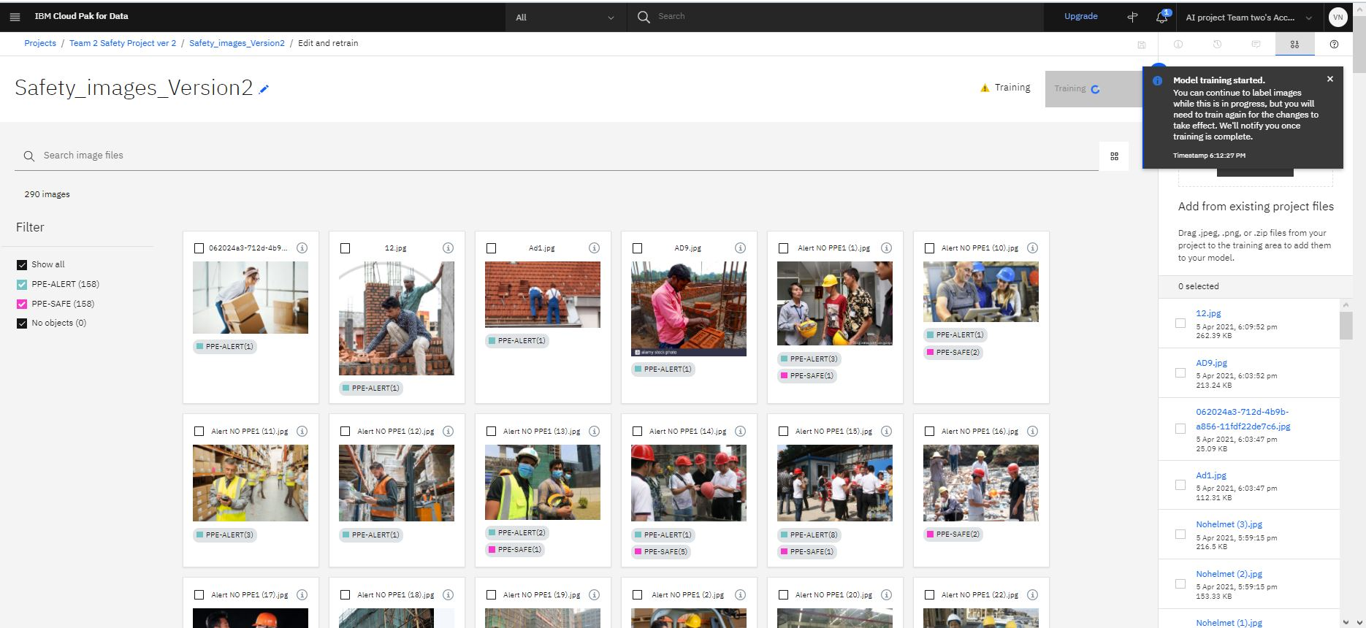
Training Ongoing...
PS, Sabiny, Venkat, Gana

Slide 40
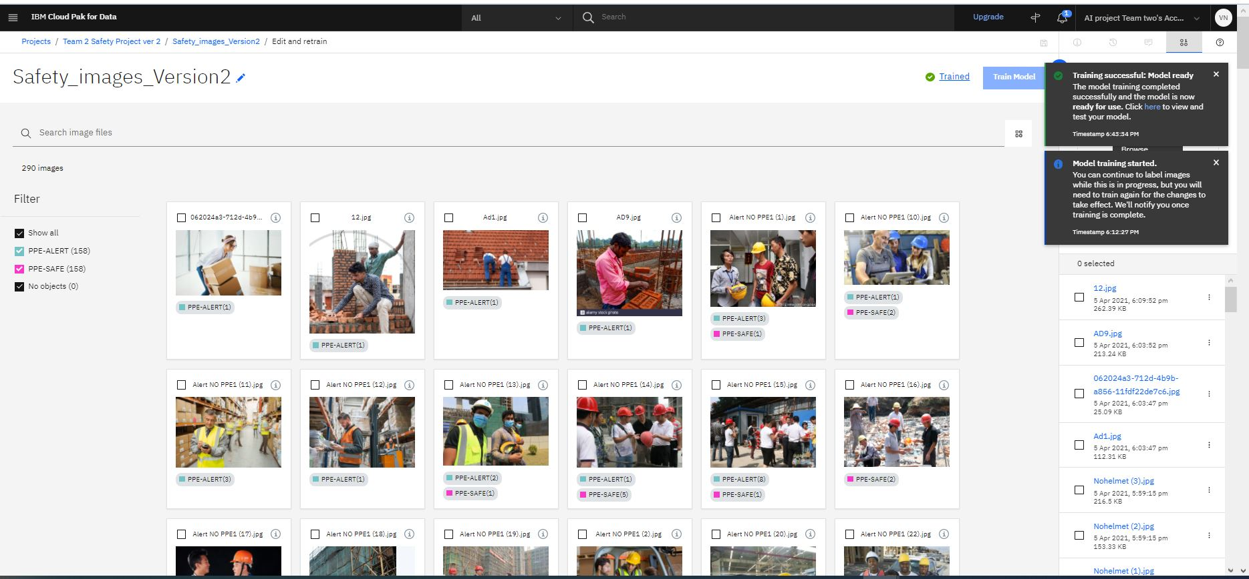
Training Completed.
PS, Sabiny, Venkat, Gana

Slide 41
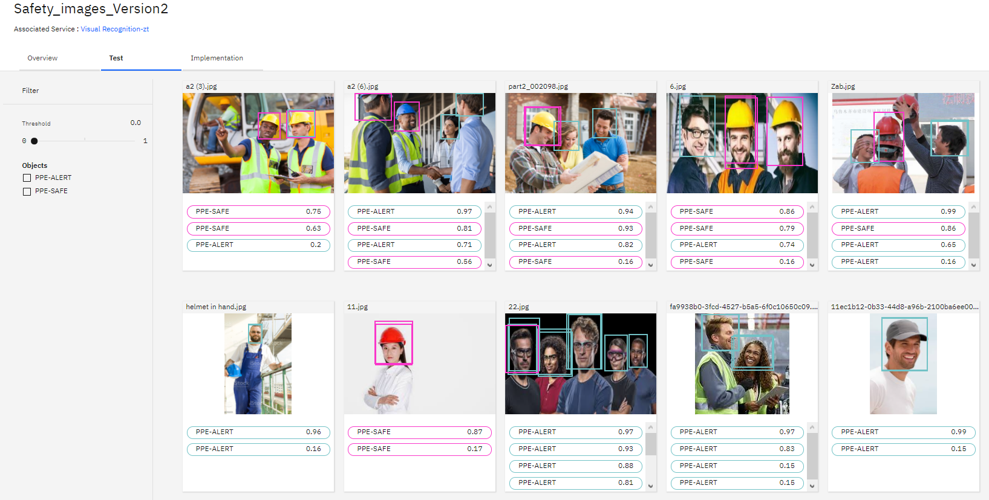
Testing...
PS, Sabiny, Venkat, Gana

Slide 42
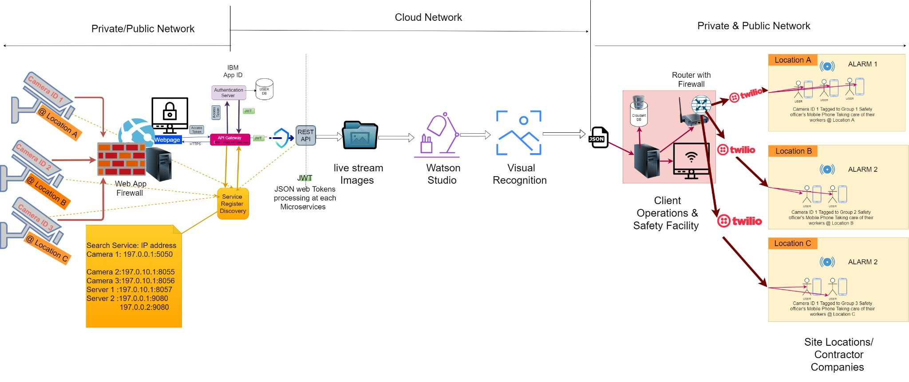
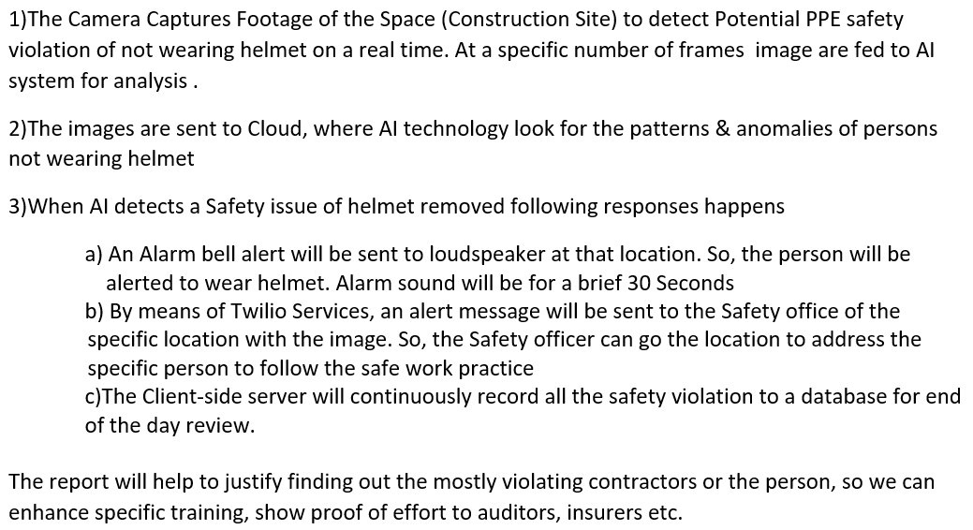
Flow Architecture
PS, Sabiny, Venkat, Gana

Slide 43
Flow Architecture

Slide 44
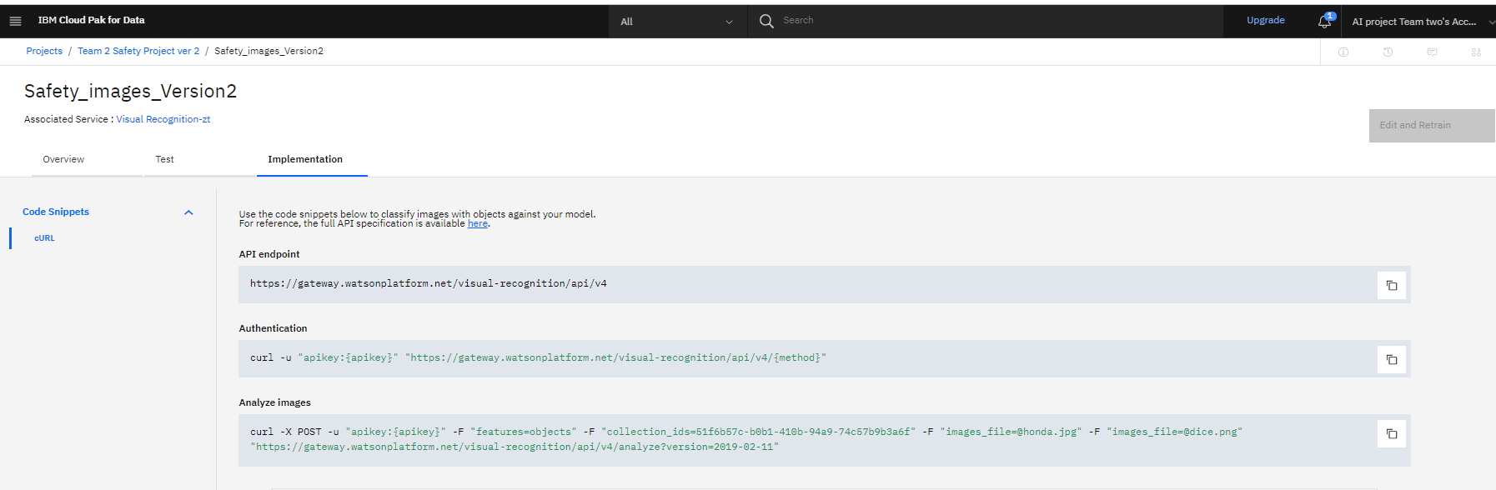
Implementation
PS, Sabiny, Venkat, Gana

Slide 45
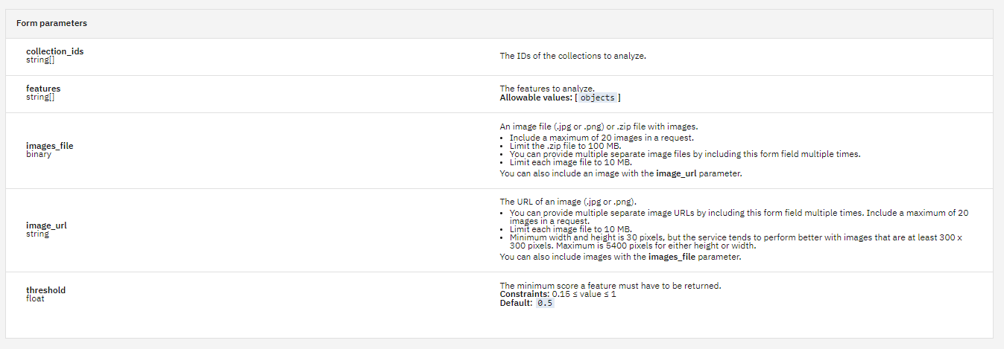
Form Parameters- Inputs from user site
PS, Sabiny, Venkat, Gana

Slide 46
EXPECTED OUTPUT
- Reasoning

Slide 47
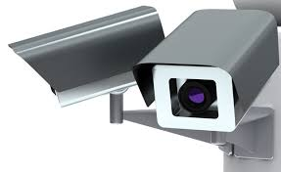
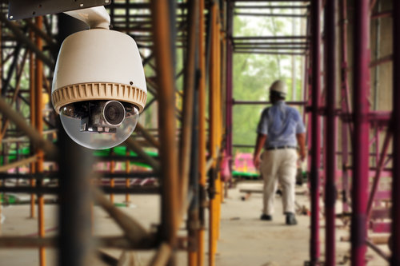
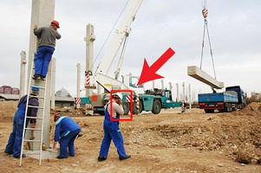
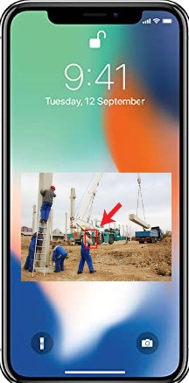

Outcome of implementing AI - Computer Vision
Detecting Safety Violation - Workers not wearing safety helmet
Surveillance of worksite
Work site installed cameras record video images of work area focusing on worker groups.
Analysis of video Frames
Watson AI object detection system scans images frames and identifies safety violations ; Workers without safety helmets
Identifying Camera ID and framing violation
Object detection system identifies location by Camera ID and highlights violation in the Image
Alert in immediate area
01
Alarm sounds in Camera covering the area
At the same time, alert message will be sent to Mobile phone of Specific safety officers covering the area
02
03
04
PS, Sabiny, Venkat, Gana

Slide 48
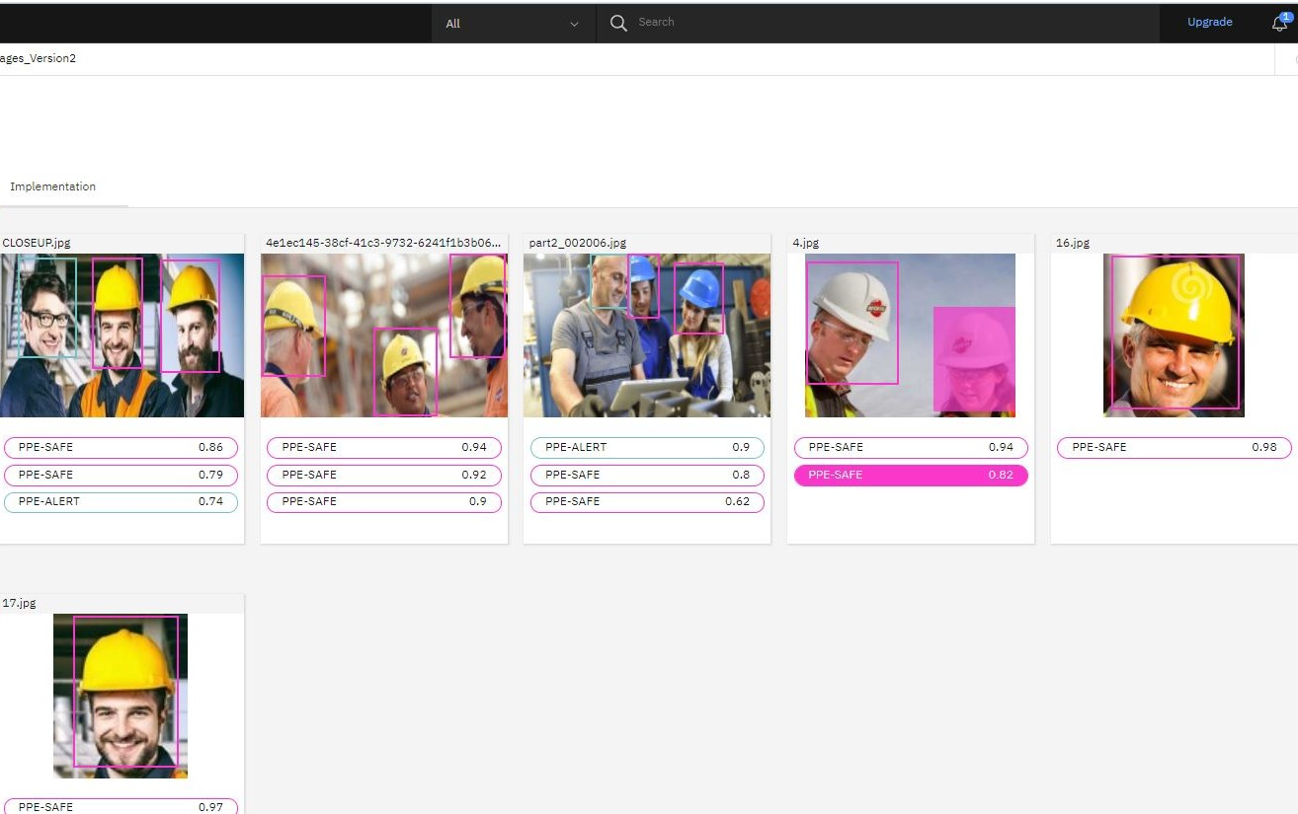
Test output of model
Analysis of the images indicates successful detection of Safe and Alert Cases in line with business requirements.
Close up and higher quality of resolution produces a better threshold score as is seen with the individual images
PS, Sabiny, Venkat, Gana

Slide 49
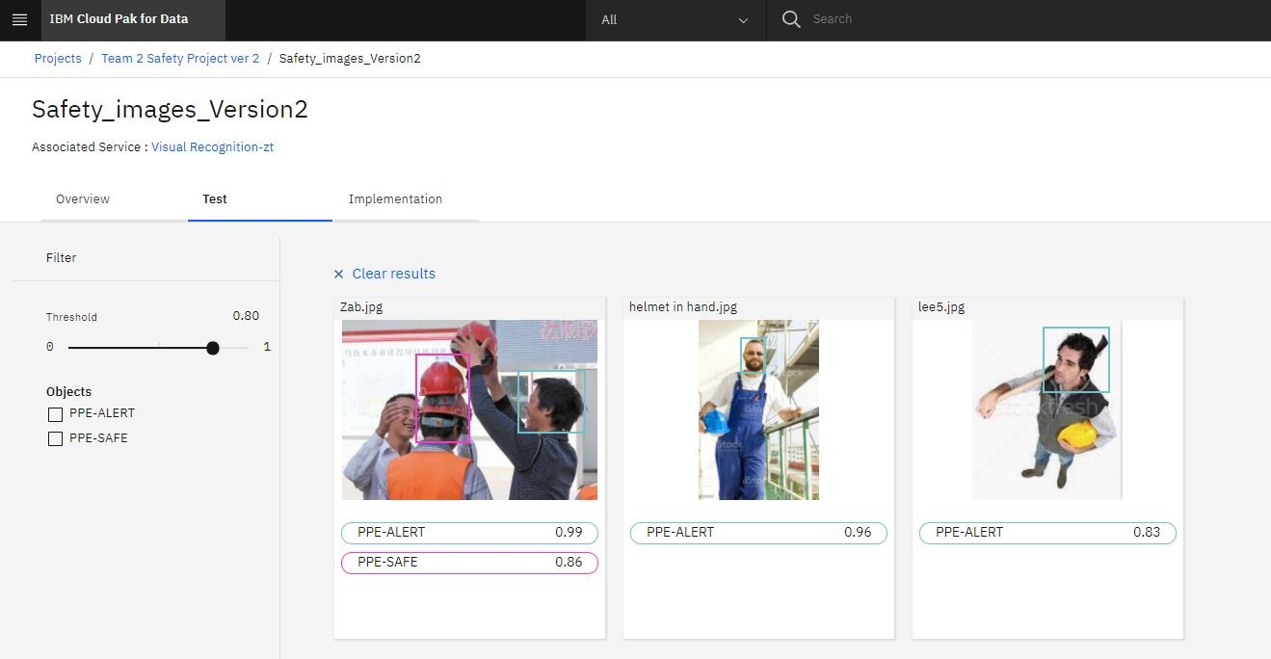
Test output of model
PPE violation detection accuracy can be further determined with these image.
Helmet not worn on the head are identified with alerts as is required for the business model
PS, Sabiny, Venkat, Gana

Slide 50
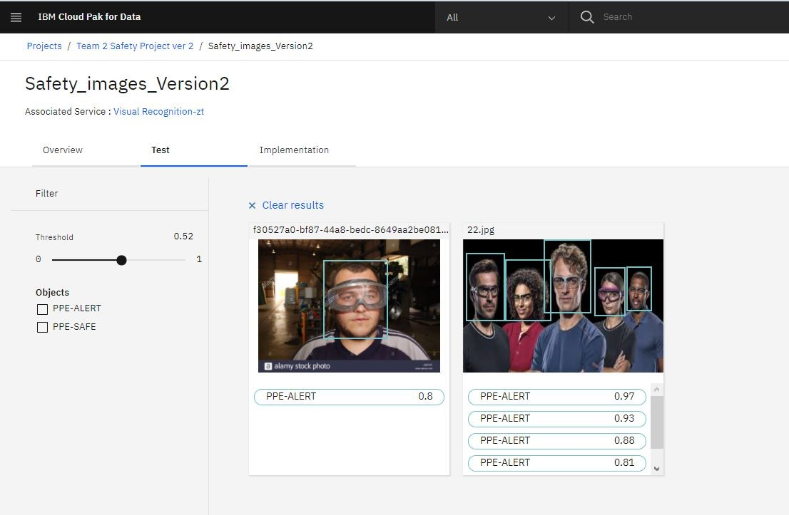
Test output of model
Images of Workers not wearing safety helmets are flagged with alerts in line with business requirements
PS, Sabiny, Venkat, Gana

Slide 51
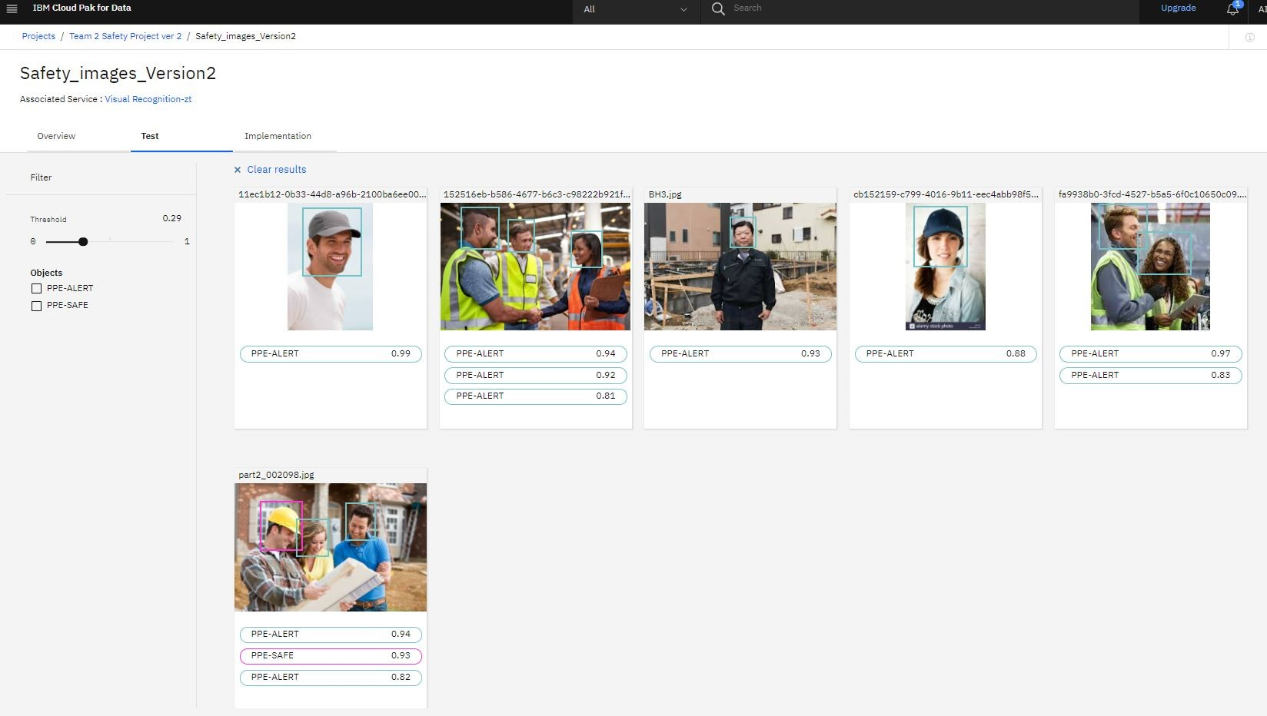
Test output of model
PPE violation of wearing normal caps and not safety helmets are detected by the system
Detects images of workers not wearing safety helmets in group images of workers
PS, Sabiny, Venkat, Gana

Slide 52
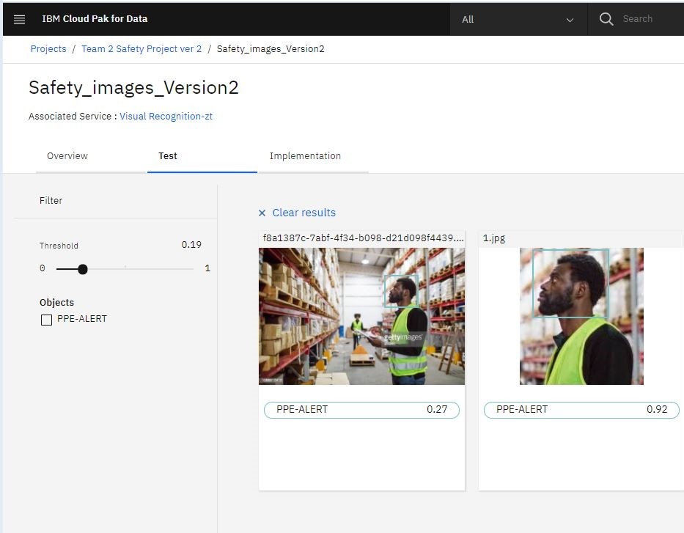
Test output of model
These images demonstrate the importance of high resolution and close up images for better prediction.
The accuracy and threshold levels for object detection improves significantly with a higher resolution close up picture of the subject
PS, Sabiny, Venkat, Gana

Slide 53
Threshold
Threshold of the test images vary between 74 and 99 percentile. Significant Number of images are in the 90 and 80 percentile range.
Threshold improves significantly with the quality, resolution and sharpness of image.
The average of the 80 percentile range is 82 and we are setting the initial threshold at 80 % with a goal of improving the threshold to 90 percentile range by training the system with high reso images from the sites.
PS, Sabiny, Venkat, Gana

Slide 54
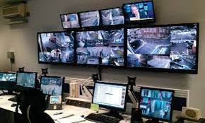
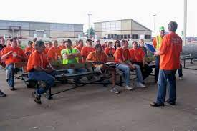


Outcome of implementing AI system
Review and prevention of Safety Violations
01
02
03
04
Monitoring server room
Safety review and planning
Analytics
Machine Learning
Review detailed analytics on safety violations by location, site etc. Reports used for internal and management reporting
Continuous training of AI model using images from video from site to increase threshold percentage
Meeting with safety officers to review safety violations using images. Discussion on enhanced safety measures, training and other admin procedures
Video recordings stored in company secure servers. Review of daily summary stats of safety and micro violations provided which will be reviewed by staff
PS, Sabiny, Venkat, Gana

Slide 55
FUTURE IMPROVEMENTS
- Knowledge

Slide 56
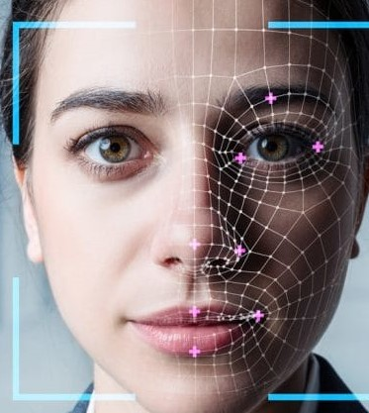
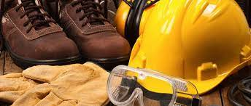
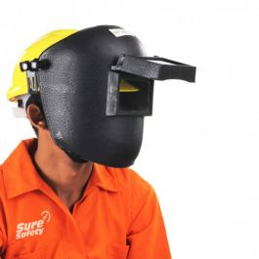

Future developments
Face Detection in Image stream
Enhance detection to identify Goggles, Boot and Glove safety Violation
Face Shield detection for welding
Analytics- Predictive analytics on likely hot spots for better deployment of officers
PS, Sabiny, Venkat, Gana

Slide 57
Challenges
Classification or object detection ?
Both methodologies work to a certain extent. However object detection identified the safety helmets on Head which was key to our project. Object detection methodology provides a bounding in the right areas of the image during testing.
Images
After the initial training and testing phase we realised that resolution and distance of the object makes a difference in threshold. However getting high resolution images that fit our requirements was a challenge as most sites have low reso images.
Training
During the initial testing phase, system wrongly classified some images. We realised that we needed additional images with specific orientation in the training file. The re-trained model provided a much better classification and threshold
Making sense of the classification and threshold
In a few instances, we noticed the same classification with multiple threshold values for images with an individual subject. Training with additional images helped in resolving this issue
www.free-powerpoint-templates-design.com
PS, Sabiny, Venkat, Gana

Slide 58
Thank You

